Slide 1
Matching Census Voting Tabulation Districts (VTD) to Arizona Election Results
August 22, 2011

Slide 2
Introduction
What are VTDs?
Voting Tabulation Districts – the level of census geography at which election results are reported
Based on each county’s precincts
Intended to allow election results to be related to the census data
How many are in AZ?
There are 2,224 VTDs in the 2010 Census.

Slide 3
Why do we have to worry about VTDs?
Voting Rights Act
Under Section 5, Arizona's redistricting plans cannot be retrogressive. The plans cannot weaken or reduce minority voters' rights.
The presence of discrimination can be determined by analyzing population data and election results.
Competitiveness
Prop. 106 establishes competitiveness as one of the criteria for re-drawing Arizona’s Congressional and Legislative Districts.
Many measures of competitiveness use past election results.

Slide 4
How are election results matched to the Census?
Census VTDs should match each county’s voting precincts from 2008 and 2010
Counties were asked not to change their precincts during these elections.
Once submitted to the Census, VTD names cannot be changed. Unfortunately, the original submission had many scrambled precinct names.
Census VTDs are comprised of Census Blocks
Once results are matched to the VTDs they are disaggregated to the block level.
Each block is allocated a percentage of the votes based on their proportion of the VTDs voting age population.

Slide 5
What issues are there?
Census VTDs are wrong in some places
Of the 2,224 VTDs in AZ, we have found that many cannot be easily matched.
If the correct election results are not assigned to the correct geographic area it will be impossible to perform correct Voting Rights Act and competitiveness analysis.

Slide 6
Methods for Identifying VTDs and Precincts
Unique Codes
Census VTDs come with a unique code (VTD_code)
Code is comprised of the county’s 5 digit fips code and the unique precinct number
Example- Maricopa’s Alta Vista Precinct
Fips = 04013
Precinct # = 15
VTD_code = 0401315
No consistency even among the VTD codes
Some counties “zero fill”
Example:
Maricopa’s Alta Vista Precinct VTD_code = 0401315
Yavapai’s Castle Hot Springs 1 Precinct VTD_code = 04025015

Slide 7
Methods for Identifying VTDs and Precincts (continued)
Name
Census has a VTD_name field
County’s also have names for their precincts
Sometimes there are minor differences that prevent automated matches
Examples:
Census = VILLA LA PAZ, County = VILLA DE PAZ
Census = Santan Heights, County = SAN TAN HEIGHTS
Census = Apache Junction NW, County = APACHE JCT NW
Census = Kearny, County = KEARNEY

Slide 8
Methods for Identifying VTDs and Precincts (continued)
Location and Shape
Each VTD occupies a unique spot on the map as does each County Precinct
Shape can be used to match County Precincts to Census VTDs
This is done by comparing total area or perimeter length

Slide 9
How was the match done?
Strategic Telemetry called every county and requested maps of their precincts, when possible we used .shp files that could be viewed directly in Maptitude. We also were able to work with .pdf maps and maps from election result reporting websites.
The match was conducted by one person and verified by another.
All available identifiable features were used to conduct the match.

Slide 10
How was the match done? (continued)
Census VTDs
Fields Included:
County
VTD Code
VTD Name
Area (sq. miles)
Fields Added:
IRC Precinct Code
County Precinct Maps
Fields Included (.shp)
Precinct #
Precinct Name
Area (sq. feet)
Field included (.pdf)
Name
Shape
Fields Added
IRC Precinct Code
Precinct Election Results (varied by county)
Fields Included
Unique Precinct code (assigned at the county level)
Unique Precinct name (assigned at the county level)
Fields Added
IRC Precinct Code

Slide 11
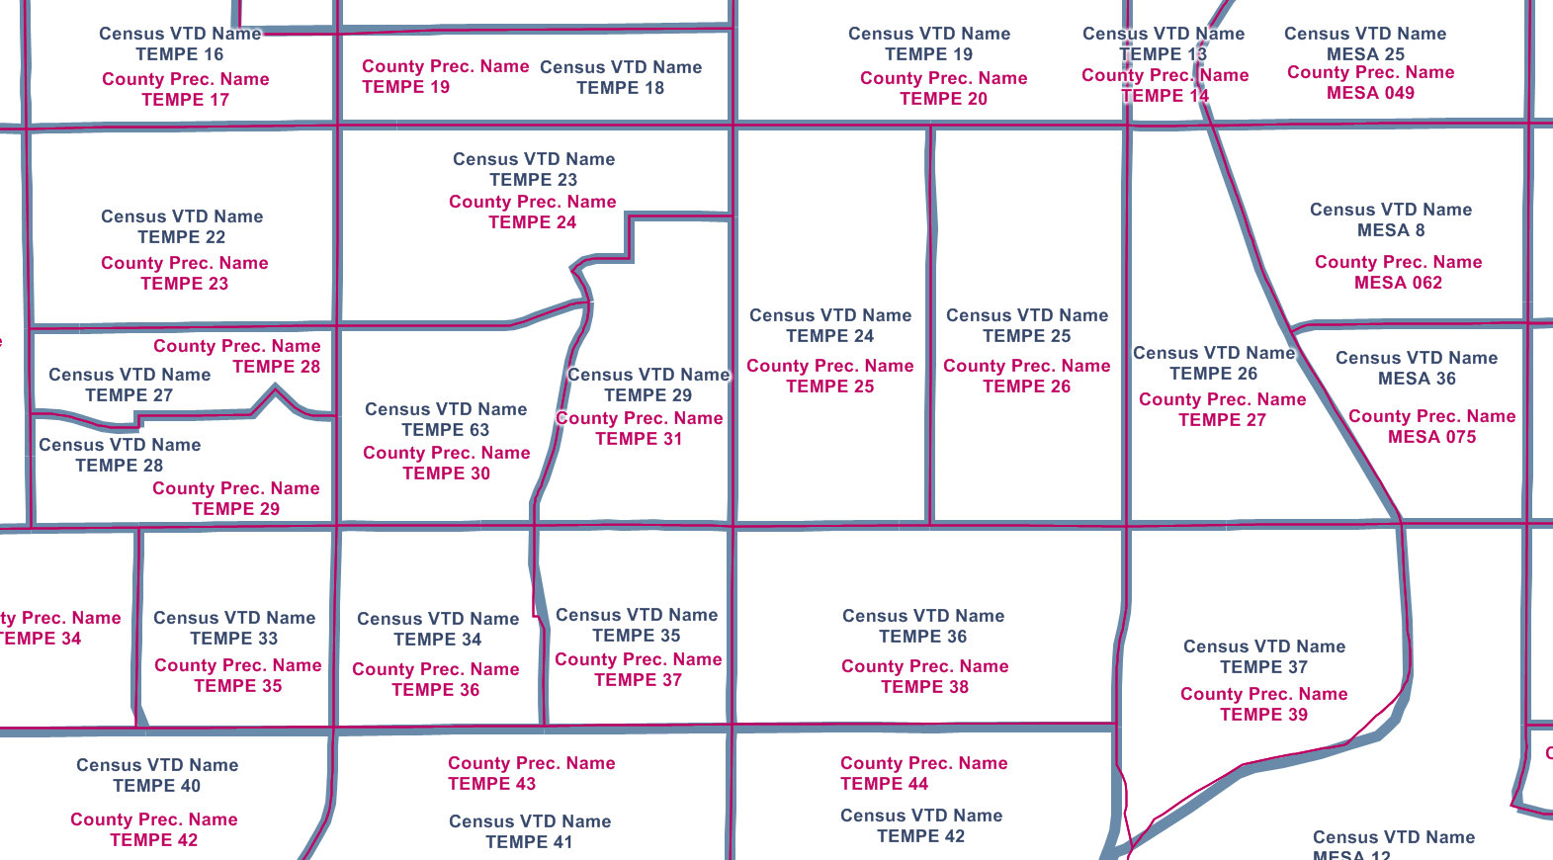
Issues Identified During the Match
VTD names that don’t match Precinct names

Slide 12
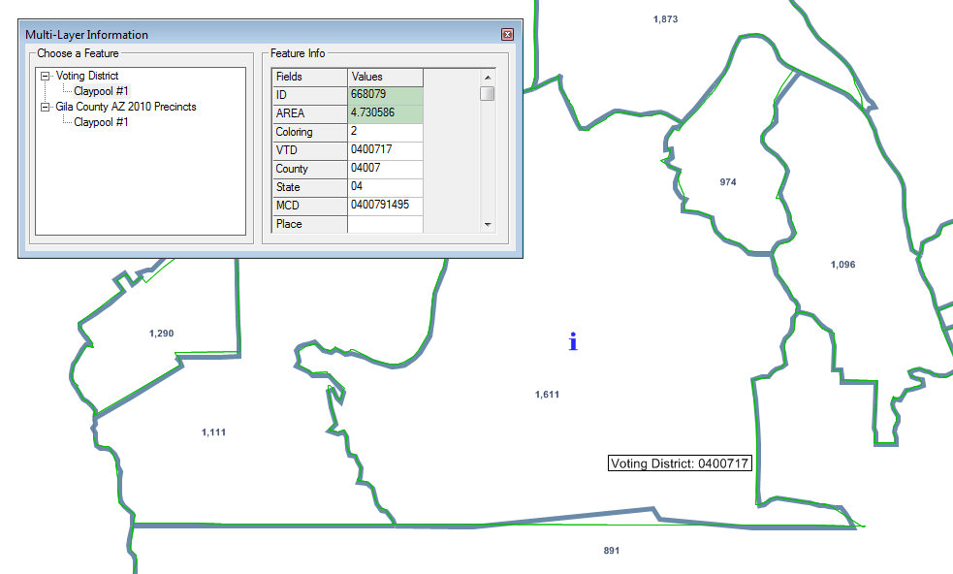
Issues Identified During the Match (continued)
VTD codes that don’t match Precinct codes

Slide 13
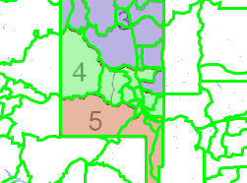
Issues Identified During the Match (continued)
Multiple Districts / Split VTDs

Slide 14
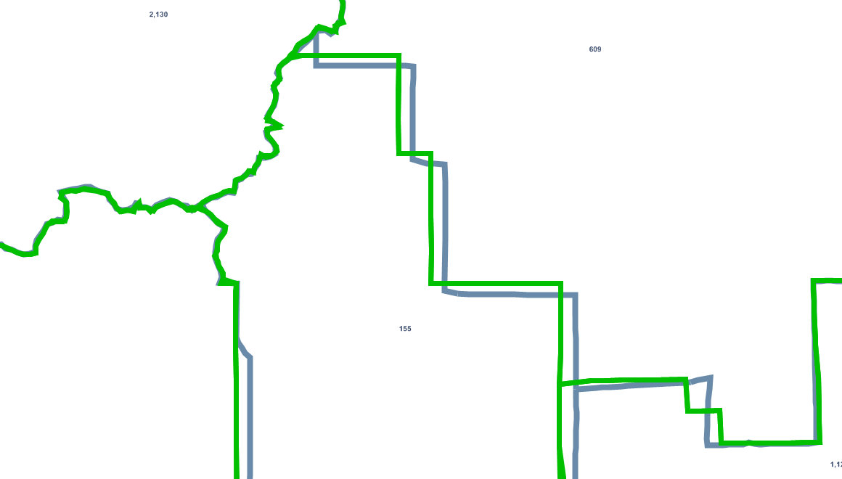
Issues Identified During the Match (continued)
Unaligned Precincts

Slide 15
Counties where no issues were found
Apache
Coconino
Greenlee
Mohave
Santa Cruz
Yuma

Slide 16
Cochise County
Total Precincts: 64
Total Issues: 3
- VTD area that doesn’t match Precinct area: 3

Slide 17
Cochise County (continued)

Slide 18
Cochise County (continued)

Slide 19
Gila County
Total Precincts: 39
Total Issues: 4
- VTD codes that don’t match Precinct number: 4

Slide 20
Gila County (continued)

Slide 21
Gila County (continued)

Slide 22
Graham County
Total Precincts: 19
Total Issues: 4
- VTD codes that don’t match Precinct number: 1
- VTD names that don’t match Precinct names: 4

Slide 23
Graham County (continued)

Slide 24
Graham County (continued)

Slide 25
La Paz County
Total Precincts: 12
Total Issues: 3
- VTD area that doesn’t match Precinct area: 3

Slide 26
La Paz County (continued)

Slide 27
La Paz County (continued)

Slide 28
Maricopa County
Total Precincts: 1,142
Total Issues: 367
- VTD codes that don’t match Precinct number: 4
- VTD names that don’t match Precinct names: 281
- VTD area that doesn’t match Precinct area: 47

Slide 29
Maricopa County (continued)

Slide 30
Maricopa County (continued)

Slide 31
Maricopa County (continued)

Slide 32
Maricopa County (continued)

Slide 33
Maricopa County (continued)

Slide 34
Navajo County
Total Precincts: 54(Census) 70(county)
Total Issues: 12 (Census)
- VTD codes that don’t match Precinct number : 2
- VTD area that doesn’t match Precinct area: 10
- Extra/Split County Precincts: 16

Slide 35
Navajo County (continued)

Slide 36
Navajo County (continued)

Slide 37
Pima County
Total Precincts: 417
Total Issues: 45
- VTD codes that don’t match Precinct number: 2
- VTD names that don’t match Precinct names: 2
- VTD area that doesn’t match Precinct area: 44

Slide 38
Pima County (continued)

Slide 39
Pima County (continued)

Slide 40
Pinal County
Total Precincts: 88
Total Issues: 43
- VTD names that don’t match Precinct names: 38
- VTD area that doesn’t match Precinct area: 6

Slide 41
Pinal County (continued)

Slide 42
Pinal County (continued)

Slide 43
Yavapai County
Total Precincts: 112
Total Issues: 19
- VTD names that don’t match Precinct names: 14
- VTD area that doesn’t match Precinct area: 6

Slide 44
Yavapai County (continued)

Slide 45
Yavapai County (continued)

Slide 46
AIRC Matching Resources
Workbook outlining all matches
Census VTD to County Precinct Verification Worksheet.xls
VTD to Precinct match key
census_vtd_to_irc_prec_key.txt or
census_vtd_to_irc_prec_key.dbf
Available on IRC website-
www.azredistricting.org

